Slide 1
Data Structure Analysis and Design

Slide 3
Dynamic Programming

Slide 4
Plan of Lecture
Introduction to Dynamic Programming.
Some simple examples for DP.
All Pair Shortest Path Algorithm.
0-1 Knapsack Problem.

Slide 5
Dynamic Programming
Dynamic Programming is a general algorithm design technique for solving problems defined by or formulated as recurrences with overlapping sub-instances
Invented by American mathematician Richard Bellman in the 1950’s to solve optimization problems and later assimilated by CS
“Programming” here means “planning”

Slide 6
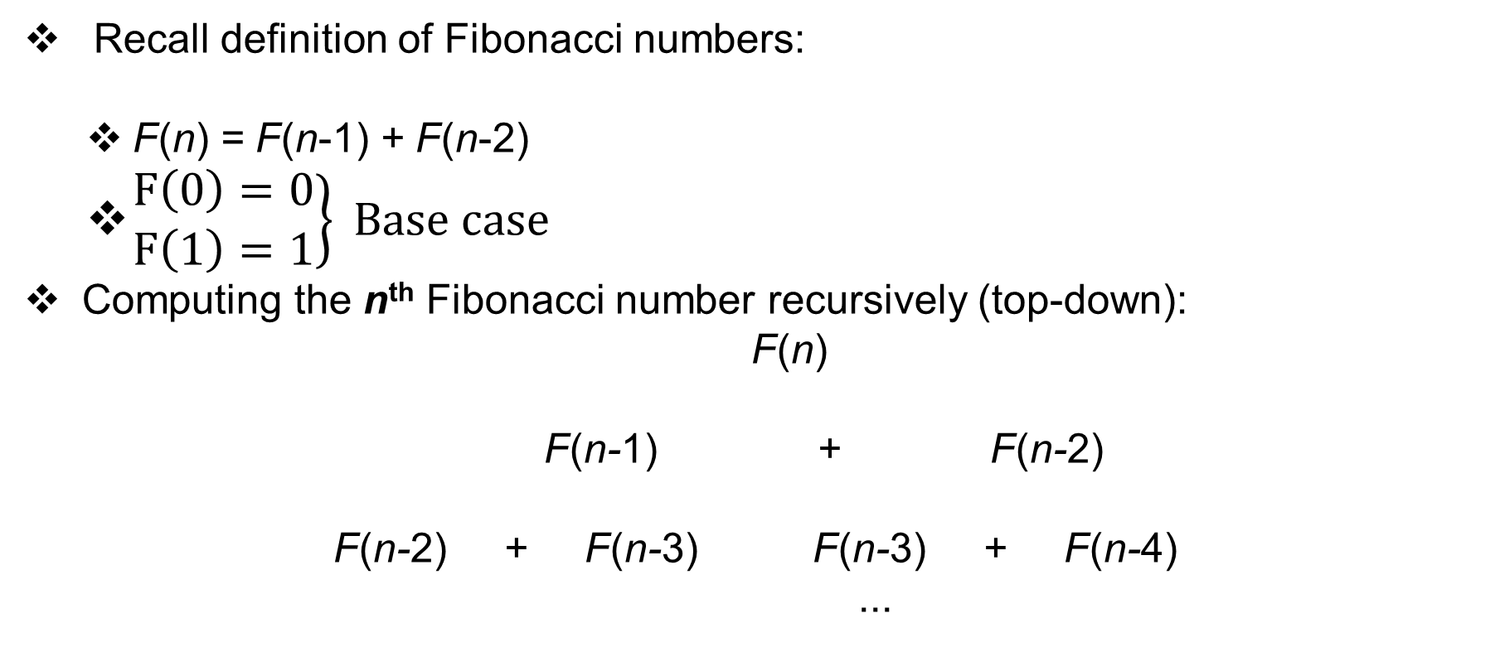
Example: Fibonacci numbers
Recall definition of Fibonacci numbers:
F(n) = F(n-1) + F(n-2)
$\left.\begin{matrix}F\left(0\right)=0 \\ F\left(1\right)=1\end{matrix}\right\} Base case$
Computing the n^{th} Fibonacci number recursively (top-down):
F(n)
F(n-1) + F(n-2)
F(n-2) + F(n-3) F(n-3) + F(n-4)
...

Slide 7
Example: Fibonacci numbers
Draw the Tree of FIB(40) & check for repeated sub problem
Check for the number of sub problems. They also follow Fibonacci sequence.

Slide 8
Example: Fibonacci numbers (cont.)
Computing the n^{th} Fibonacci number using bottom-up iteration and recording results:
F(0) = 0
F(1) = 1
F(2) = 1+0 = 1
…
F(n-2) =
F(n-1) =
F(n) = F(n-1) + F(n-2)
Efficiency:
Time n
Space n

Slide 9
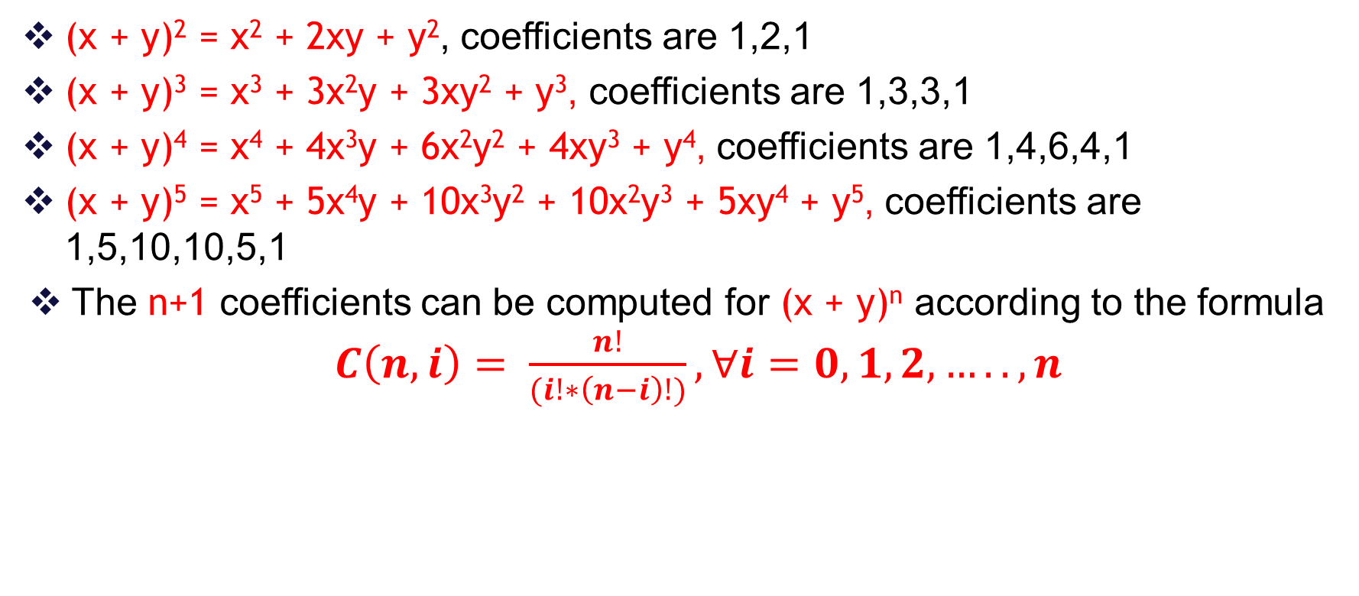
Example 2: Binomial Coefficients
(x + y)² = x² + 2xy + y², coefficients are 1,2,1
(x + y)³ = x³ + 3x²y + 3xy² + y³, coefficients are 1,3,3,1
(x + y)⁴ = x⁴ + 4x³y + 6x²y² + 4xy³ + y⁴, coefficients are 1,4,6,4,1
(x + y)⁵ = x⁵ + 5x⁴y + 10x³y² + 10x²y³ + 5xy⁴ + y⁵, coefficients are 1,5,10,10,5,1
The n+1 coefficients can be computed for (x + y)^{n} according to the formula $C\left(n,i\right)= \frac{n!}{(i!∗\left(n−i\right)!)}, ∀i=0,1,2,….., n$

Slide 10
Example 2: Binomial Coefficients
Check for (x + y)⁷
The repeated computation of all the factorials gets to be expensive.
We can use dynamic programming to save the factorials as we go

Slide 11
Solution by dynamic programming
n c(n,0) c(n,1) c(n,2) c(n,3) c(n,4) c(n,5) c(n,6)
0 1
1 1 1
2 1 2 1
3 1 3 3 1
4 1 4 6 4 1
5 1 5 10 10 5 1
6 1 6 15 20 15 6 1
7 1 7 21 35 35 21 7 1
Each row depends only on the preceding row
Only linear space and quadratic time are needed
This algorithm is known as Pascal’s Triangle

Slide 12
Dynamic Programming
Main idea:
Set up a recurrence relating a solution to a larger instance to solutions of some smaller instances
Solve smaller instances once
Record solutions in a table
Extract solution to the initial instance from that table and create the solution of the bigger problem.

Slide 13
Comparison with Divide-and-Conquer
Divide-and-Conquer algorithms:
split a problem into separate sub-problems,
solve the sub-problems, and
combine the results for a solution to the original problem
Example: Quick sort, Merge sort, Binary Search.
Can be thought of as top-down algorithms
Dynamic Programming algorithm:
Proceeds by solving small problems, then combining them to find the solution to larger problems
Can be thought of as bottom-up

Slide 14
Steps in Dynamic Programming
Characterize structure of an optimal solution.
Define value of optimal solution recursively.
Compute optimal solution values either top-down with caching or bottom-up in a table.
Construct an optimal solution from computed values.
The problem must have the optimal substructure property: “the optimal solution to the problem, contains within it, optimal solutions to smaller subproblems.”
Typically the number of different Overlapping subproblems is polynomial, but the recursive algorithm implementing the recursive formulation of the problem is exponential. This is because of overlapping calls to same subproblem

